Slide 1
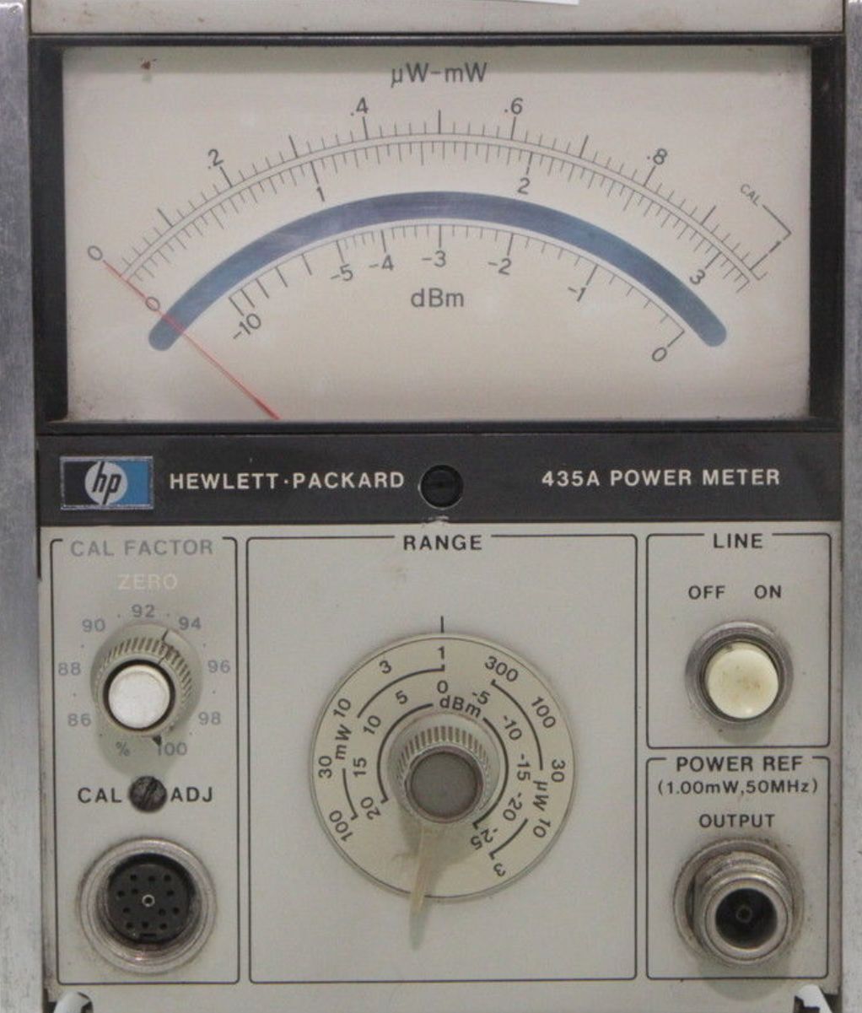
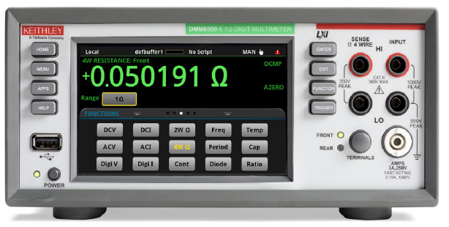
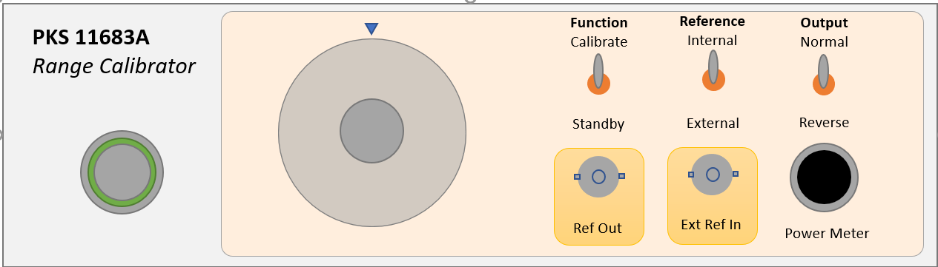
Range Calibrator Usage
POWER METER
UNDER REPAIR
VOLT METER
CALIBRATOR
Rear panel
recorder output

Slide 2
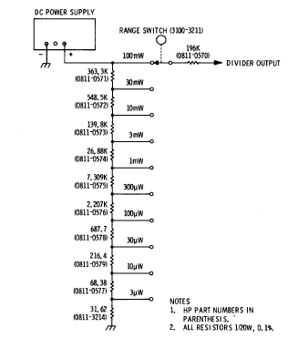
Voltage Divider method
12.8V
Spare Sensor
Detector
Thermocouple / Diode
Chopper
Amp
Disconnect
Detector

Slide 3
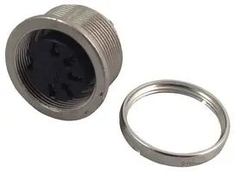
Block Diagram
Amphenol
T 3638 000
Zero
Int/Ext
Ref
Polarity
Switch
Line
Supply
Divider
Chopper
2x FET
Amp
1 NPN
Power 12.8V
Out
Feedback
Chop
Ext
Ref

Slide 4
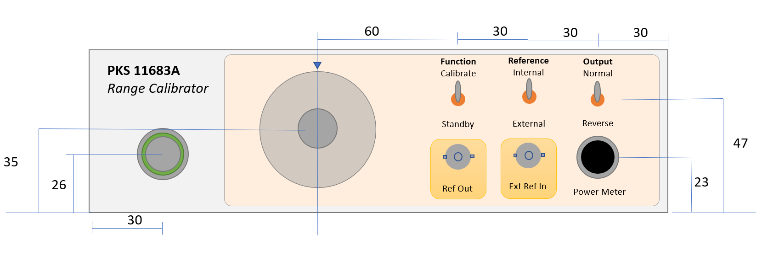
Box and layout - draft
PSU
Height 76mm
Width 250mm
Depth (front to back) 165mm
Int Depth 150mm
Support plate 10mm from base

